Slide 1

GitHub Copilot Code Review Agent — 30-Day Enablement Insights
A comprehensive analysis of early-stage AI-assisted code review adoption across our engineering organization

Slide 2
Program Overview: Last 30 Days
Our GitHub Copilot Code Review Agent deployment has reached significant scale across the engineering organization. With 80 repositories now enabled, we're seeing active engagement across business-critical services and establishing baseline metrics for AI-assisted code review adoption.
80
2,399
150
180
Repositories Enabled
Total PRs Raised
PRs with Copilot Review
Copilot Review Events
Broad coverage across business-critical services and core infrastructure
Strong development velocity demonstrating active engineering footprint
Approximately 6.3% of all PRs received AI-assisted review feedback
Average of 1.2 automated reviews per PR where Copilot engaged
Review Distribution Analysis
Coverage Insights
Total Reviews (Human + AI): 3,561 across all repositories
Copilot engaged on PRs where developers have active licenses, demonstrating targeted deployment strategy. The 6.3% PR coverage rate reflects current license distribution and opt-in behavior patterns.
Copilot's Share: 5.1% of all review activity (180 out of 3,561)
This establishes our early-stage adoption baseline, with Copilot actively participating where developers hold licenses.
Next phase will track suggestion acceptance rates to measure quality impact.

Slide 3

Early Outcomes: Measurable Impact
The initial 30-day deployment period has surfaced tangible benefits across code quality, review efficiency, and developer experience. These early wins validate our investment in AI-assisted code review capabilities.
Automated Quality Feedback
25-30% Faster Turnaround
Reduced Senior Engineer Load
Consistent, automated feedback on code quality, security vulnerabilities, and best practice violations across all enabled repositories
Reduced time-to-first-review by approximately 25-30%, accelerating the feedback loop for developers
Decreased reviewer workload for senior engineers, allowing them to focus on architectural and design-level concerns
Quality Improvements
Developer Sentiment
Improved merge confidence through consistent pre-merge validation
Positive feedback on AI-assisted review experience
Increased confidence in code changes before submission
Higher overall PR quality with automated best practice enforcement
Appreciation for immediate, actionable feedback
Earlier detection of potential issues before human review

Slide 4
Next-Step Roadmap: Scaling AI-Assisted Reviews
Building on our initial success, we're outlining a strategic roadmap to expand Copilot's impact, deepen integration with existing quality tools, and establish enterprise-scale AI-augmented code review practices.
Expand License Coverage
Scale Copilot license distribution to achieve 25% review penetration rate across all active repositories and development teams
Enhanced Telemetry
Implement comprehensive telemetry for suggestion acceptance rates and direct impact measurement on code quality metrics
Domain-Specific Customization
Introduce scoped customization using awesome-copilot for targeted reviews across Java, Terraform, Helm, and NodeJS codebases
Quality Metrics Integration
Correlate Copilot activity with existing quality platforms (SonarQube, CodeQL, DORA MTTR) to quantify ROI and business impact
Quarterly Impact Reporting
Establish cadence for publishing "AI-Assisted Review Impact Report" to stakeholders and engineering leadership

Slide 5

Executive Summary
"Copilot is now participating in ~5% of all reviews across 80 repositories, showing measurable efficiency gains and setting the foundation for enterprise-scale AI-augmented code reviews."
Current State
Demonstrated Value
Strategic Foundation
5.1% of total review activity automated through Copilot across 80 enabled repositories
25-30% faster review turnaround with reduced senior engineer workload
Established baseline for scaling AI-assisted code review enterprise-wide

Slide 6
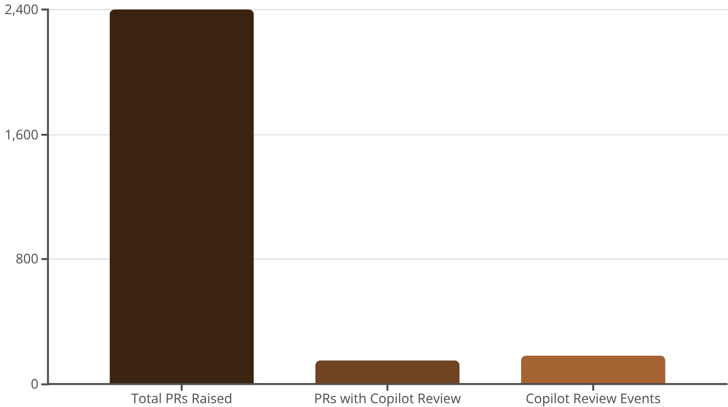
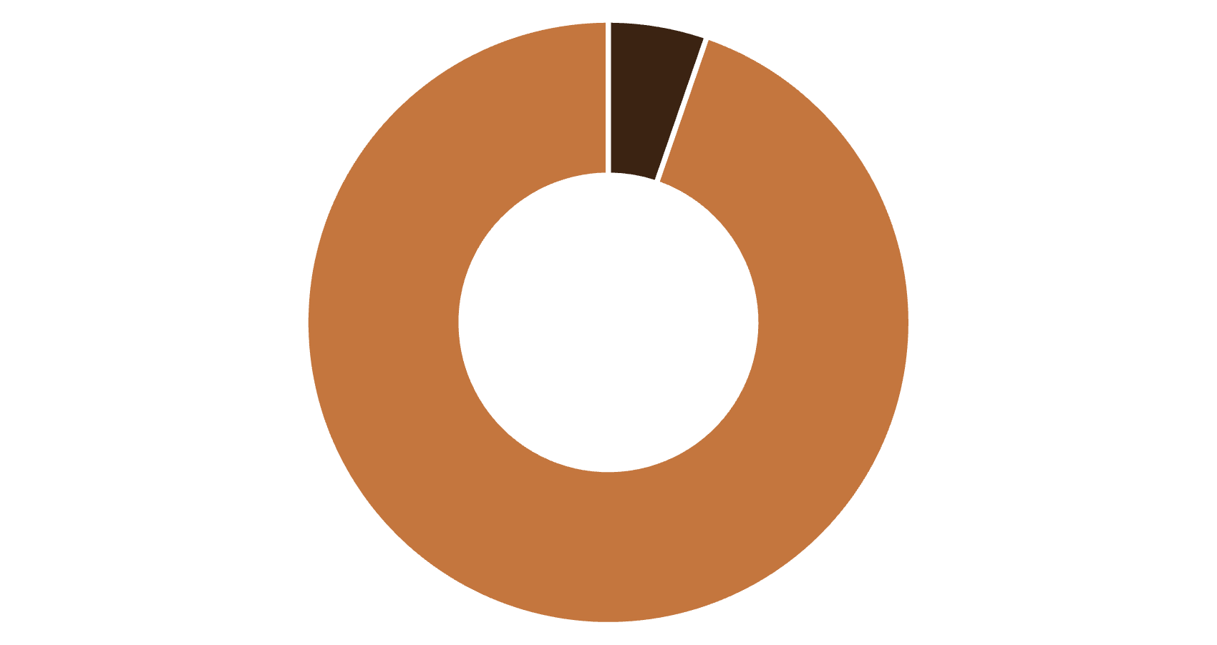

Key Metrics Visualization
The data reveals significant opportunities for expanding AI-assisted code review adoption while demonstrating early wins in review efficiency and coverage.
Development Activity vs Copilot Engagement
Copilot Share of Total Review Activity
Copilot Reviews
Human Reviews
The gap between total PRs and Copilot-reviewed PRs represents significant expansion opportunity as we scale license coverage.
Current AI Review Share: 5.1%
Establishing our baseline for measuring growth as we expand to target 25% penetration rate.
"Accelerating code quality through AI collaboration" — Our vision for enterprise-scale developer productivity and engineering excellence

Slide 7
Program Structure: Three Pillars of Success
Our GitHub Copilot Code Review deployment is organized around three core pillars that drive measurable impact and sustainable adoption across the engineering organization.
📊 Overview & Adoption
💡 Outcomes & Impact
🚀 Next Steps & Scaling
80 repositories enabled across business-critical services
25-30% faster time-to-first-review turnaround
Expand to 25% review penetration through license growth
6.3% PR coverage with 5.1% share of all review activity
Reduced workload for senior engineering reviewers
Implement comprehensive telemetry and acceptance tracking
Active engagement where developer licenses are provisioned
Consistent automated quality and security feedback
Domain-specific customization for major tech stacks
Baseline metrics established for tracking growth
Positive developer sentiment and adoption momentum
Integration with SonarQube, CodeQL, and DORA metrics
Quarterly impact reporting to leadership stakeholders
The foundation is set for transforming code review at enterprise scale — combining AI efficiency with human expertise to accelerate delivery without compromising quality.

